Slide 1



Hotel Management System
Presented by: NGENZI Blaise
ID: 27488
Course: Database Development with PL/SQL (INSY 8311)
Lecturer: Eric Maniraguha
Date: 27 March 2025
Problem Statement:
Imagine checking into a hotel after a long journey, only to find your reservation missing, your room double-booked, or payments taking ages to process! 😫 Many hotels still rely on outdated, manual systems, leading to long waits, billing mistakes, and frustrated guests. Our PL/SQL-based Hotel Management System is here to change that! 🚀 By automating reservations, check-ins, payments, and service management, we create a seamless, hassle-free experience for both guests and staff—ensuring speed, accuracy, and top-notch hospitality! 🏨

Slide 2
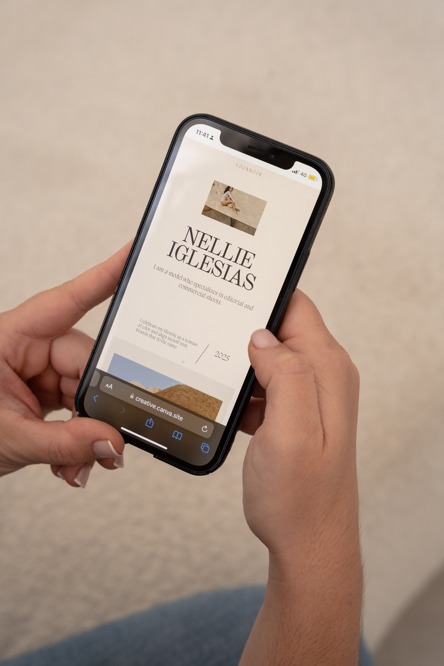

Exciting Features & Smart Database Design 🎯
What makes our system awesome?
📅 Effortless Bookings – No more overbooking headaches!
🛎 One-Tap Check-In & Check-Out – Speed up hotel services.
💳 Secure Payments – Say goodbye to billing errors.
👨‍💼 Efficient Staff Management – Track roles & responsibilities easily.
📊 Real-Time Insights – Get instant reports on hotel performance!
How the system is structured:
🏨 Guests – Who’s staying at the hotel?
🛏 Rooms – What’s available & what’s booked?
📅 Bookings – Manage reservations without errors.
💰 Payments – Track transactions securely.
👨‍💼 Staff – Keep hotel operations running smoothly.
Seamless Relationships:
Guests can book multiple rooms.
Payments link directly to bookings.
Room availability updates in real-time!

Slide 3



Why this system is a win:
⚡ Lightning-Fast Hotel Operations – No more waiting around!
🎯 Zero Booking Errors – A smooth experience for every guest.
🏆 VIP-Level Guest Satisfaction – A stress-free, enjoyable stay.
💰 Accurate Revenue Tracking – Every payment recorded properly.
Next Big Steps:
🏗 Build the Database – Lay the foundation.
📝 Write Smart PL/SQL Code – Automate processes.
🛠 Test & Improve – Make sure it’s flawless!

